Slide 1



SMART INDIA HACKATHON 2025
TITLE PAGE
Problem Statement ID – SIH25080
Problem Statement Title - AI-Driven Train Induction Planning & Scheduling for Kochi Metro Rail Limited (KMRL)
Theme - Transportation & Logistics
PS Category - Software
Team ID -
Team Name (Registered on portal) – Code Blooded

Slide 2



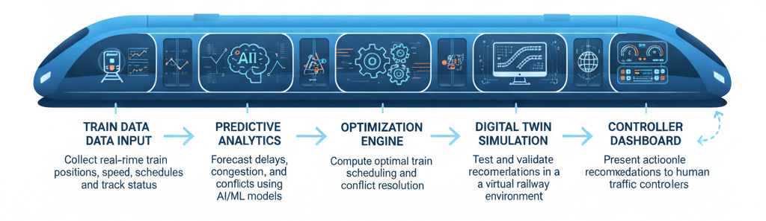
Code Blooded
Maximizing Section Throughput Using Al-Powered Precise Train Traffic Control
Proposed Solution
Innovation & Uniqueness:
Central AI platform to unify all induction-related data.
Automated data ingestion from Maximo, IoT, and manual inputs.
Multi-objective optimization for scheduling trains.
Real-time conflict detection with alerts and notifications..
Machine learning to improve accuracy over time.
Hybrid AI + Optimization: Combines ML predictions with scheduling algorithms.
Digital Twin Integration: Validates decisions in a safe, simulated environment.
Dynamic Prioritization: Balances train priorities (express, passenger, freight) in real-time.
Resource Efficiency: Maximizes section throughput using existing infrastructure.
Controller-Friendly: Supports human decision-making without replacing it.
AI-Driven Train Induction Planning & Scheduling : END TO END WORKFLOW

Slide 3


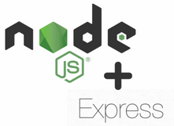



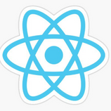







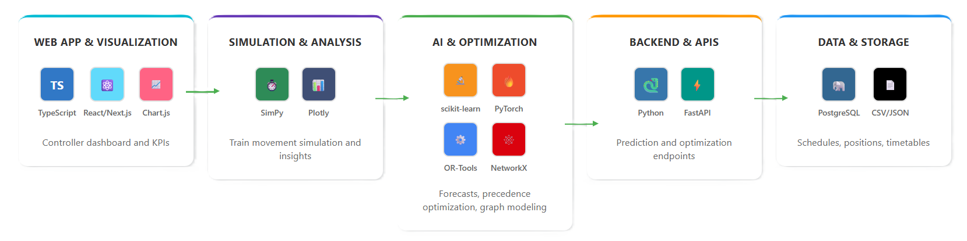
TECHNICAL APPROACH
Code Blooded
Technologies used:
Programming Languages: Python (AI, simulation, backend), JavaScript/TypeScript (frontend/dashboard)
AI & ML: Scikit-learn, TensorFlow/PyTorch (predictions & reinforcement learning), Prophet/ARIMA (delay forecasting), NetworkX (railway network modeling)
Optimization & Simulation: SimPy (train movement simulation), PuLP/OR-Tools (schedule optimization), DEAP (heuristic optimization), Matplotlib/Plotly (visualization)
Database & Data Handling: SQLite/PostgreSQL (store schedules & positions), CSV/JSON (prototyping)
Web & Dashboard: React/Next.js (dashboard), D3.js/Chart.js/Plotly (charts), FastAPI/Flask (API for predictions)
Real-Time Rail Control: The Technologies Used in each stage

Slide 4







FEASIBILITY AND VIABILITY
Code
Blooded
Feasibility
AI, ML, and optimization algorithms are mature, well-documented, and open-source.
Railway scheduling and tracking APIs (like NTES) provide real-time train data.
Simulation frameworks (SimPy, Digital Twin) allow safe testing.
Supporting Facts for Feasibility & Viability
Kochi Metro currently manages 25 trainsets, projected to expand to 40 by 2027.
Manual planning takes place in a short 2-hour window (21:00–23:00), increasing error risk.
Even a single clearance miss can affect 99.5% punctuality KPI.
Poor mileage allocation accelerates wear, inflating maintenance costs.
Global metro systems (e.g., Singapore MRT, Hong Kong MTR) already leverage AI for predictive scheduling, proving practicality.
Viability
1.Reduces operational delays and improves punctuality KPIs for metro services.
2.Minimizes maintenance costs by ensuring balanced mileage allocation.
3.Enhances compliance with branding commitments, protecting revenue streams.
4.Lowers energy use and safety risks by reducing unnecessary shunting.
5.Scales effectively with KMRL’s planned fleet expansion, ensuring long-term sustainability.
Challenges
Use Cases
Integrating predictive AI models with real-time train data streams.
Optimization algorithms may occasionally produce near-optimal solutions that need human validation.
Ensuring security and privacy of sensitive operational data.
Train Induction– Automated nightly train induction planning for metro depots.
Conflict Resolution – Optimize track allocation and train scheduling to avoid collisions.
Throughput Maximization – Increase the number of trains handled per section without compromising safety.
Controller Dashboard – Provide actionable insights, alerts, and visualization of real-time train movements.
Feedback Loop – Continuously improve predictions based on real-time data.
Prototype
https://onam-sync.vercel.app/

Slide 5
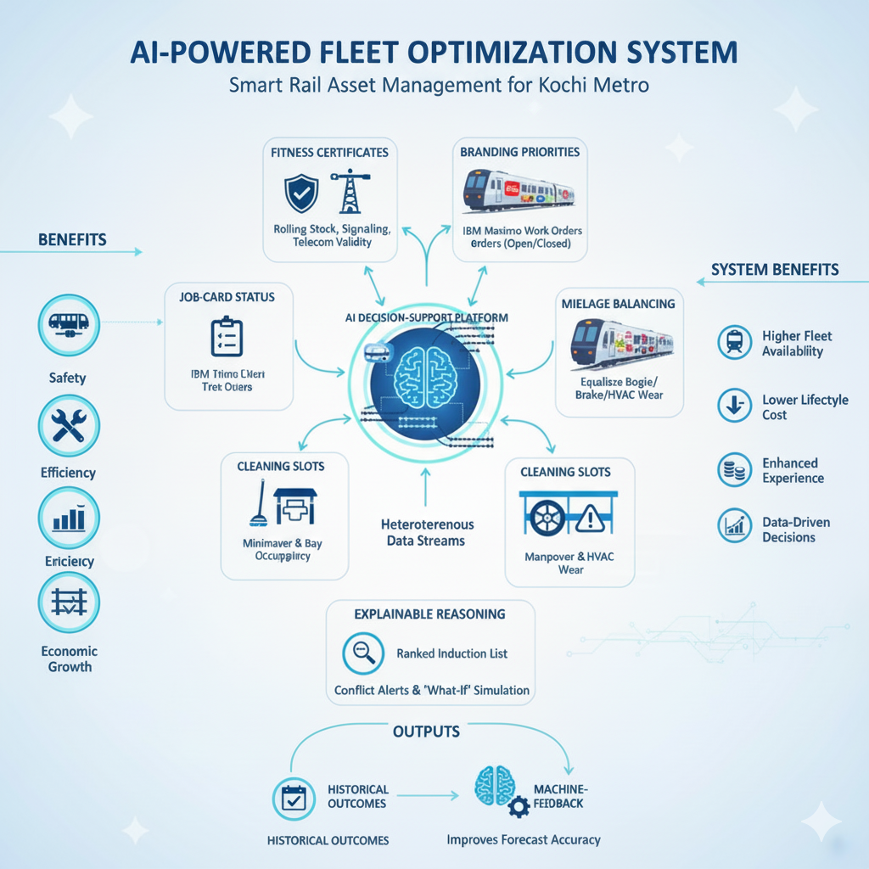

IMPACT AND BENEFITS
Code Blooded
Potential Impact on Target Audience
Passengers / Train Travelers: Safer and more reliable train journeys, fewer delays, proactive alerts during disruptions.
Railway Controllers & Authorities: Faster decision-making, optimized track usage, improved operational efficiency.
Railway Management / Indian Railways: Data-driven scheduling insights, higher punctuality, increased throughput of trains.
Government & Transport Planners: Better infrastructure utilization, actionable insights for policy and investment.
Benefits of the Solution
Social Benefit: Enhanced safety, punctuality, and comfort for passengers; reduces human errors in traffic control.
Economic Benefit: Improved train throughput reduces delays, boosting operational efficiency and passenger satisfaction.
Operational Benefit: Reduces manual workload for traffic controllers; AI assists in decision-making.
Reputational Benefit: Positions Indian Railways as a technologically advanced, smart, and efficient transportation system.
6

Slide 6


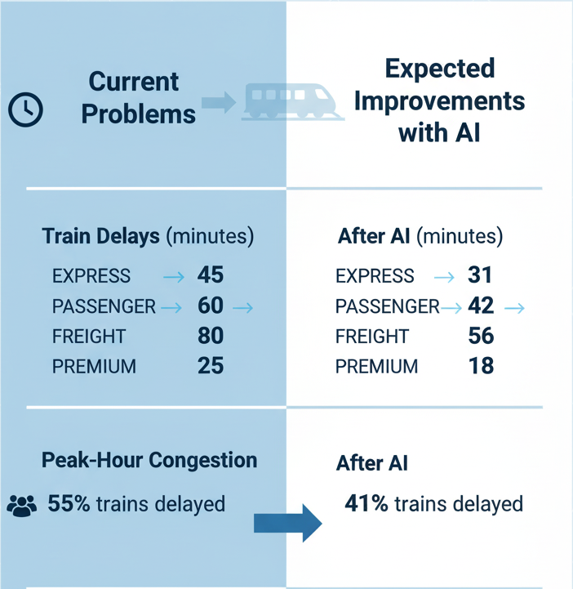

RESEARCH AND REFERENCES
Code Blooded
Code Blooded
References
Key Research Insights
Books
Hansen I. A., Pachl J. (eds.). Railway Timetabling and Operations: Analysis, Modelling, Optimisation, Simulation, Performance Evaluation. Eurailpress, 2014 -ch. 6, pp. 145–188, 17-18 Oct. 2025.
Patty B. W. (ed.). Handbook of Operations Research Applications at Railroads. Springer, International Series in Operations Research & Management Science, 2015 - ch. 12, pp. 301–348, 18-19 Oct 2025.
IEEE papers
Versluis N. D., Quaglietta E., Goverde R. M. P., Pellegrini P., Rodriguez J., “Real-time railway traffic management under moving-block signalling: A literature review and research agenda.” IEEE Transactions on Intelligent Transportation Systems, 2024.
Zhang Y., Luan X., Corman F., Li K., “Distributed optimization for real-time railway traffic management.” IEEE IFAC-Papers online, vol. 51, no. 9, pp. 337–342, 15-16, Oct. 2025
Articles
TRL (Transport Research Laboratory), “Options for capacity measures and metrics.” Office of Rail and Road (UK) Technical Report, 2014.
Sangphong O., Siridhara S., Ratanavaraha V., “Determining critical rail line blocks and minimum train headways for equal and unequal block lengths and various train speed scenarios.” Engineering Journal, vol. 21, no. 3, pp. 281–296, 15 Oct. 2025.

